Slide 1
FIDELITY BANK TRAINING PROGRAMME
IT STANDARDS TRAINING
By
Benedict Anyalenkeya
FCA, ACCA, CISA, CRIC, MCP, BS7799LA, COBIT, CICPP

Slide 2
Agenda
IT Standards:
Overview of IT Standards Requirements (CBN Standards Blueprint)
IT Governance
PCIDSS
ISO 27001
How to Implement IT Standards

Slide 3
What is IT Standards
Technology standards establish boundaries for technology usage, specifying technology to be used (acceptable use) and restricting access to technology that is deemed "non-standard".
These standards cover the following area
Technology governance
Technology Management
Enterprise architecture
Service delivery and Management
Information Security and disaster recovery

Slide 4
Problems with Lack of Standards
Internal Fraud
Poor customer service
Project Management Failures
Low return on Investment
Poor credit rating
High cost of running Technology
Poor System Security & Controls
Errors & Ommissions
Risk of bank failure

Slide 5
Technology Capability Development Areas for Nigerian Banks (2014 – 2019)

Slide 6
STRATEGIC IT ALIGNMENT
Translation of business vision and strategies into multi year IT investments and operating plans as well as impacts of IT on enterprise performance measurement
.

Slide 7
IT GOVERNANCE
Framework for initiation, endorsement, sponsorship, approval, and evaluation of IT Decisions
.

Slide 8
Architecture & Information Management
Guidance for the creation and execution of Strategic IT architecture framework
.

Slide 9
Solutions Delivery
Framework for the development of software Application solutions and their subsequent transition into the production environment
.

Slide 10
Service Management & Operations
Planning, delivery & Measurement of day-to-day Operational Service
.

Slide 11
Information & Technology Security
Security & Protection of Enterprise Information and Related Assets

Slide 12
Workforce & Resource Management
Management of IT Skills, Knowledge & Banking Resources

Slide 13
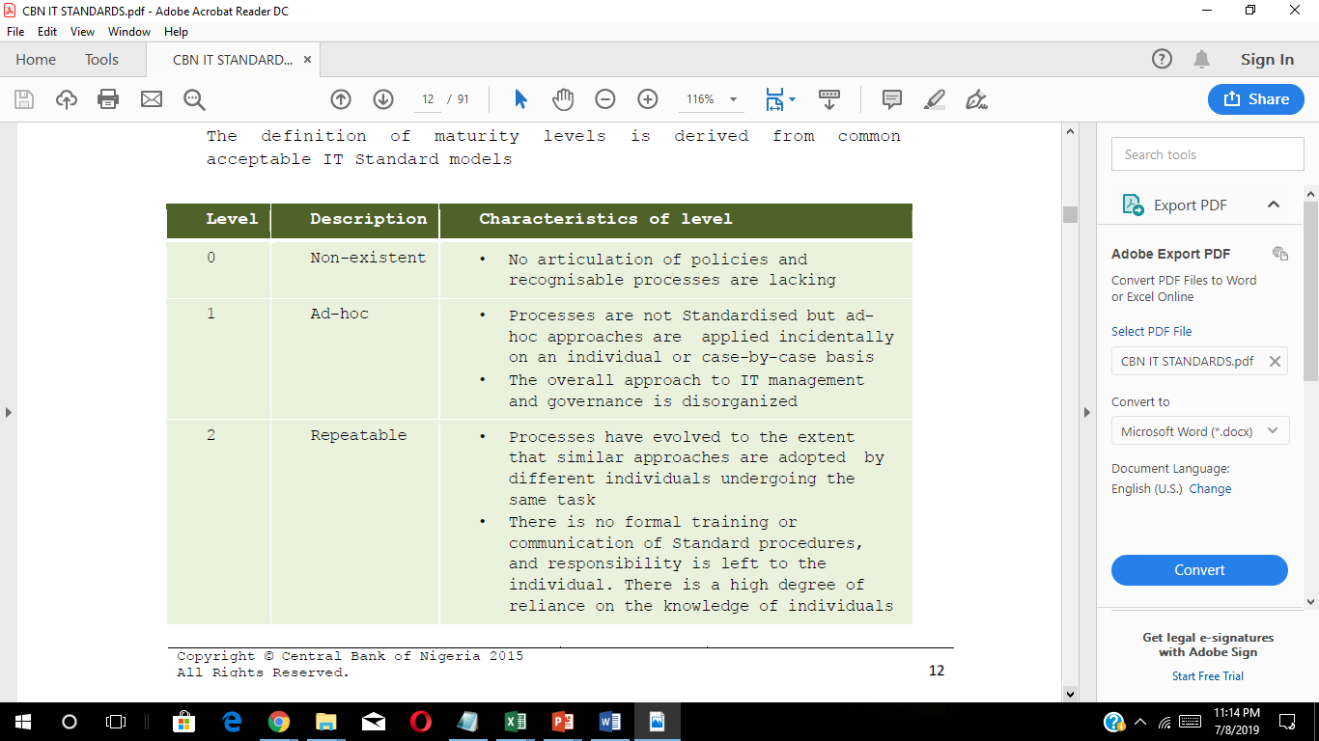
TARGET MATURITY LEVELS
Maturity levels indicate the robustness of formal articulation of policies and the extent of assimilation and adoption into organizational practices.

Slide 14
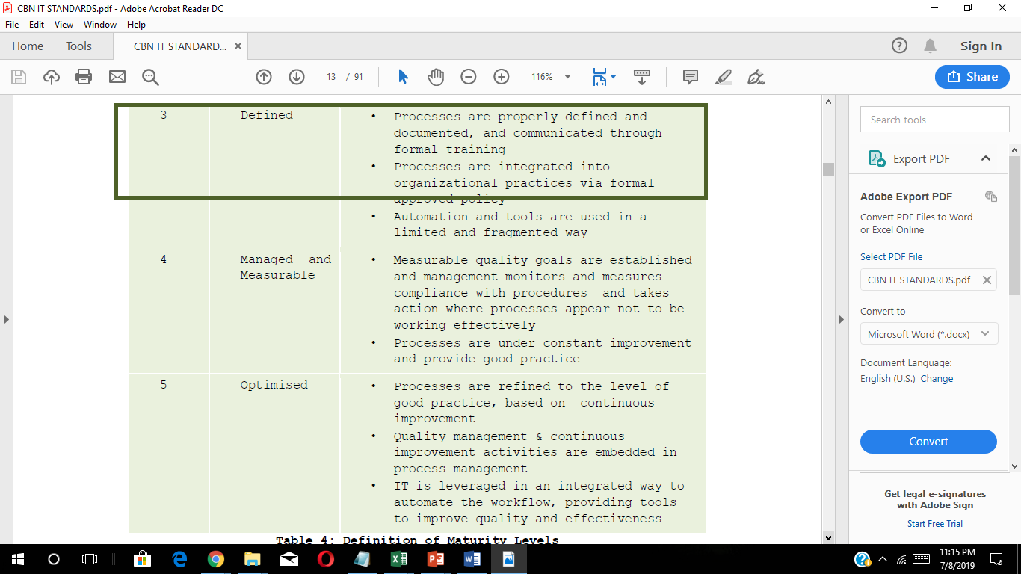
TARGET MATURITY LEVELS

Slide 16
The Standards
COBIT
ITIL
PCIDSS
ISO27001
ISTOGAF
CMMI
SBRL
PRINCE2
PMBOK
TIER 942
BCI
SFIA
OUR FOCUS
COBIT
PCIDSS
ISO27001
SFIA
BCI

Slide 17
IT GOVERNANCE
COBIT 5
By ISACA
CONTROL OBJECTIVES FOR INFORMATION TECHNOLOGY
Information Systems Audit & Control Association

Slide 18
IT Governance & Management
Governance ensures that ;
- Stakeholder needs
- Conditions and
- Options
are evaluated to determine balanced, agreed-on enterprise objectives to be achieved;
Setting direction through prioritization and decision making;
and Monitoring performance and compliance against agreed-on direction and objectives.
Governance should be the responsibility of the Board of Directors under the leadership of the chairperson.

Slide 19
Governance Vs Mgt
GOVERNANCE RESPONSIBILITIES
Evaluate to determine balanced, agreed-on enterprise objectives to be achieved
Direct through prioritization and decision making
Monitor performance, compliance and progress against agreed direction and objectives.
EVALUATE - DIRECT - MONITOR

Slide 20
Governance Vs Mgt
MANAGEMENT IS IN THE BUSINESS OF
PLANNING
MANAGEMENT ACTIVITIES
BUILDING
RUNNING
MONITORING
activities in alignment with the direction set by the governance body to achieve the enterprise objectives

Slide 21
Why we separate governance and management?
One of most important things about IT governance is that, historically, IT has been told to govern themselves but it is extremely difficult in practice.
IT team need direction and guidance from a higher authority to provide expected values to the organization.
By separating governance and management from each other we not only try to promote accountability at all organizational levels but also achieve a mechanism for good enterprise governance that focuses on stakeholder value by balancing performance and conformance.

Slide 22
PCIDSS
Payment Card Industry Digital Security Standards

Slide 23
PCIDSS
An information security standard for organizations that handle branded credit and debit from the major card schemes.
MASTERCARD
VERVE
VISA
UNION PAY
JCB
ALIPAY
DINERS CLUB

Slide 24
Requirements Of PCI Data Security Standards
There are twelve requirements for compliance, organized into six logically related groups called "control objectives".
The six groups are:
Build and Maintain a Secure Network and Systems
Protect Cardholder Data
Maintain a Vulnerability Management Program
Implement Strong Access Control Measures
Regularly Monitor and Test Networks
Maintain an Information Security Policy

Slide 25
12 Requirements for Building & Maintaining a Secure Network & Systems
Install and maintain a firewall configuration to protect cardholder data.
2. Change vendor-supplied defaults for system passwords and other security parameters.
3. Protect stored cardholder data.
Encryption, hashing, masking and truncation are methods used to protect card holder data.
4. Encrypt transmission of cardholder data over open, public networks. Strong encryption, including using only trusted keys and certifications reduces risk of being targeted by malicious individuals through hacking.

Slide 26
12 Requirements for Building & Maintaining a Secure Network & Systems
5.Protect all systems against malware and performing regular updates of anti-virus software.
6. Develop and maintain secure systems and applications.
Vulnerabilities in systems and applications allow unscrupulous individuals to gain privileged access. Security patches should be immediately installed to fix vulnerability and prevent exploitation and compromise of cardholder data.
7. Restrict access to cardholder data to only authorized personnel.
8.Identify and authenticate access to system components.
Each person with access to system components should be assigned a unique identification (ID) that allows accountability of access to critical data systems.

Slide 27
12 Requirements for Building & Maintaining a Secure Network & Systems
9. Restrict physical access to cardholder data.
10. Track and monitor all access to cardholder data and network resources. Logging mechanisms should be in place to track user activities that are critical to prevent, detect or minimize impact of data compromises.
11. Test security systems and processes regularly.
12. Maintain an information security policy for all personnel

Slide 28
PCI Compliance Levels
All companies who are subject to PCI DSS standards must be PCI compliant.
There are four levels of PCI Compliance and these are based on how much your process per year, as well as other details about the level of risk assessed by payment brands.
At a high level, the levels are following:
Level 1 – Over 6 million transactions annually
Level 2 – Between 1 and 6 million transactions annually
Level 3 – Between 20,000 and 1 million transactions annually
Level 4 – Less than 20,000 transactions annually

Slide 29
ISO/IEC 27001
INFORMATION SECURITY STANDARD
INTERNATIONAL ELECTROTECHNICAL COMMISSION
INTERNATIONAL STANDARDS ORGANISATION
Specifies a management system that is intended to bring information security under management control and gives specific requirements

Slide 30
How ISO27001 Works
Organizations that meet the requirements may be certified by an accredited certification body following successful completion of an audit.
ISO/IEC 27001 requires that management:
Systematically examine the organization's information security risks, taking account of the threats, vulnerabilities, and impacts;
Design and implement a coherent and comprehensive suite of information security controls and/or other forms of risk treatment (such as risk avoidance or risk transfer) to address those risks that are deemed unacceptable; and
Adopt an overarching management process to ensure that the information security controls continue to meet the organization's information security needs on an ongoing basis.

Slide 31
How ISO27001 Works
Organizations that meet the requirements may be certified by an accredited certification body following successful completion of an audit.
ISO/IEC 27001 requires that management:
Systematically examine the organization's information security risks, taking account of the threats, vulnerabilities, and impacts;
Design and implement a coherent and comprehensive suite of information security controls and/or other forms of risk treatment (such as risk avoidance or risk transfer) to address those risks that are deemed unacceptable; and
Adopt an overarching management process to ensure that the information security controls continue to meet the organization's information security needs on an ongoing basis.

Slide 32
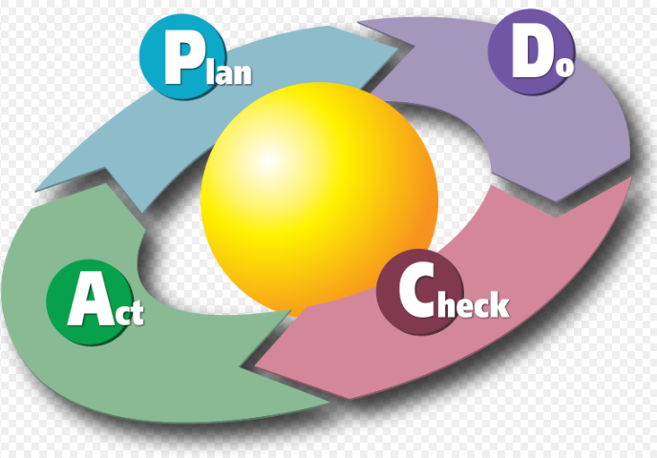
PCDA CYCLE

Slide 33
PCDA CYCLE
Plan (establishing the ISMS)
Establish the policy, the ISMS objectives, processes and procedures related to risk management
and the improvement of information security to provide results in line with the global policies
and objectives of the organization.
Do (implementing and workings of the ISMS)
Implement and exploit the ISMS policy, controls, processes and procedures.
Check (monitoring and review of the ISMS)
Assess and, if applicable, measure the performances of the processes against the policy, objectives
and practical experience and report results to management for review.
Act (update and improvement of the ISMS)
Undertake corrective and preventive actions, on the basis of the results of the ISMS internal audit
and management review, or other relevant information to continually improve the said system.

Slide 34
SFIA (Skills Framework For Information Age) - SOPHIA
A model for describing and managing skills and competencies for professionals working in ICT, software engineering and digital transformation.
It is a global common language for describing skills and competencies in the digital world.
Describes
6 Professional Skills
7 Areas of Responsibility

Slide 35
6 PROFESSIONAL LEVELS
Relationships & Engagement
Skills & Quality
Delivery & Operation
Development & Implementation
Change & Transformation
Strategy & Architecture

Slide 36
7 LEVELS OF SFIA RESPONSIBILITIES
1. FOLLOW
Basic capability to complete tasks under close supervision. Not expected to use much initiative. Should be organised.
3. APPLY
Complete work packages with milestone reviews only. Escalates problems under own discretion. Works with suppliers and customers. May have some supervisory responsibility. Performs a broad range of tasks, takes initiative, and schedules own and others work.
(Professional)
4. ENABLE
Works under general direction in a framework. Influence at account level, works on a broad range of complex activities. Good level of operational business skills.
(Senior Professional)
2. ASSIST
Uses some discretion and has a wider circle of interaction than level 1, especially in speciality. Works on a range of tasks, and proactively manages personal development.
(Associate Professional)

Slide 37
7 LEVELS OF SFIA RESPONSIBILITIES
5. ENSURE & ADVISE
Broad direction, supervisory, objective setting responsibility. Influences organisation. Challenging and unpredictable work. Self sufficient in business skills.
(Principal Professional)
7. Set Strategy, Inspire, Mobilise
Authority includes setting policy. Makes decisions critical to organisation, influences key suppliers and customers at top level. Leads on strategy. Full range of management and leadership skills.
6. INITIATE & influence
Authority for an area of work. Sets organisational objectives. Influences policy, significant part of organisation, and customers and suppliers at a high level. Highly complex and strategic work. Initiates and leads technical and business change.
(Lead professional)

Slide 38
Benefits of SFIA
Enable ICT and the broader Business to work toward similar goals
Can provide a clear understanding of standardized, leveled ICT skills across the organization
Enable targeted training, to address specific skill gaps
Improve ICT recruitment
Assist with Performance Development of existing staff

Slide 39
BCI – ISO22301
Understand and prioritize the threats to your business with the international standard for business continuity.
ISO 22301 specifies the requirements for a management system to protect against, reduce the likelihood of, and ensure your business recovers from disruptive incidents.
Extreme weather
Fire
Flood
Natural disaster
Theft
IT outage
Staff illness
Terrorist attack.
The ISO 22301 management system lets you identify threats relevant to your business and the critical business functions they could impact. And it allows you to put plans in place ahead of time to ensure your business doesn’t come to a standstill.

Slide 40
Benefits of Implementing BC Standards
Identify and manage current and future threats to your business
Take a proactive approach to minimizing the impact of incidents
Keep critical functions up and running during times of crises
Minimize downtime during incidents and improve recovery time
Demonstrate resilience to customers, suppliers and for tender requests

Slide 41
How to Implement IT Standards
Understand the required standards
Have an Acceptable Use Policy
Continous Awareness
Periodic exam on the standard
Develop an IT Policy
People to study and sign the document

Slide 42
THANK YOU

